Slide 1
Learn OpenGL

Slide 2
目录
CONTENTS
1
立方体贴图
2
实例化

Slide 3
1
立方体贴图

Slide 4
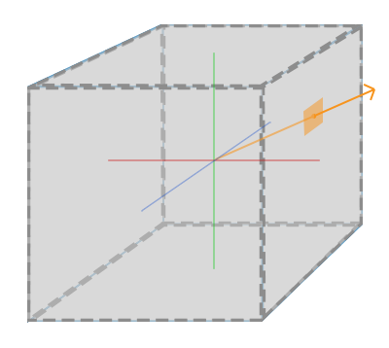
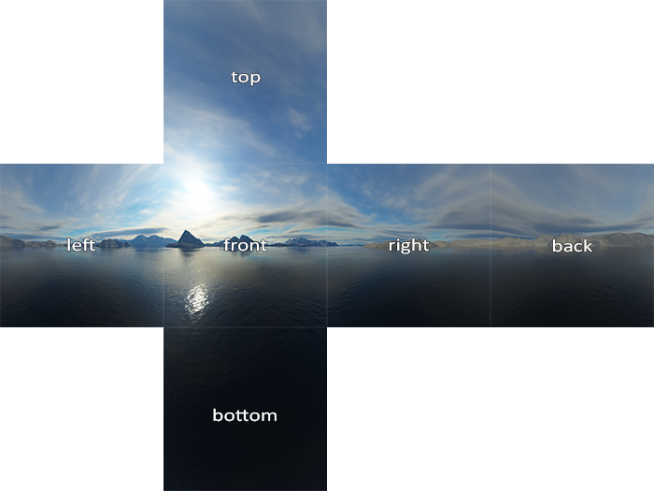
立方体贴图
立方体贴图是一个包含了6个2D纹理的纹理，每个2D纹理都组成了立方体的一个面。
为什么要把6张纹理合并到一张纹理中，而不是直接使用6个单独的纹理呢？立方体贴图有一个非常有用的特性，可以通过一个方向向量来进行索引/采样。

Slide 5
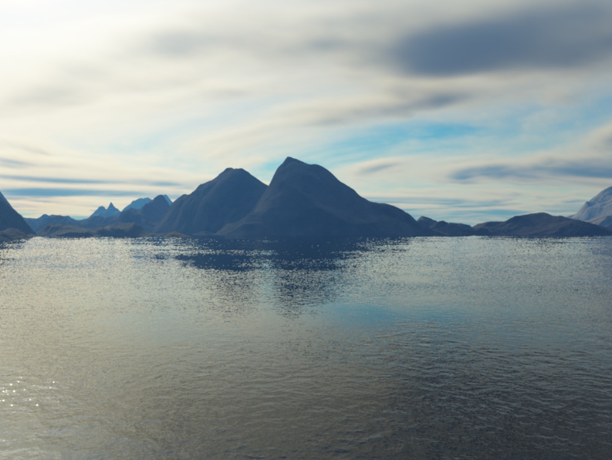
立方体贴图
立方体贴图是一个包含了6个2D纹理的纹理，每个2D纹理都组成了立方体的一个面。
为什么要把6张纹理合并到一张纹理中，而不是直接使用6个单独的纹理呢？立方体贴图有一个非常有用的特性，可以通过一个方向向量来进行索引/采样。

Slide 6
立方体贴图
创建立方体贴图
unsigned int uiID;
glGenTextures(1, &uiID);
glBindTexture(GL_TEXTURE_CUBE_MAP, uiID);
int iWidth(0), iHeight(0), iComponent(0);
for (unsigned int i = 0; i < vecCubeMap.size(); i++)
{
unsigned char* pImageData = stbi_load(vecCubeMap[i].c_str(), &iWidth, &iHeight, &iComponent, 0);
if (pImageData)
{
glTexImage2D(GL_TEXTURE_CUBE_MAP_POSITIVE_X + i, 0, GL_RGB, iWidth, iHeight, 0, GL_RGB, GL_UNSIGNED_BYTE, pImageData);
}
}
glTexParameteri(GL_TEXTURE_CUBE_MAP, GL_TEXTURE_MIN_FILTER, GL_LINEAR);
glTexParameteri(GL_TEXTURE_CUBE_MAP, GL_TEXTURE_MAG_FILTER, GL_LINEAR);
glTexParameteri(GL_TEXTURE_CUBE_MAP, GL_TEXTURE_WRAP_S, GL_CLAMP_TO_EDGE);
glTexParameteri(GL_TEXTURE_CUBE_MAP, GL_TEXTURE_WRAP_T, GL_CLAMP_TO_EDGE);
glTexParameteri(GL_TEXTURE_CUBE_MAP, GL_TEXTURE_WRAP_R, GL_CLAMP_TO_EDGE);
return uiID;

Slide 7
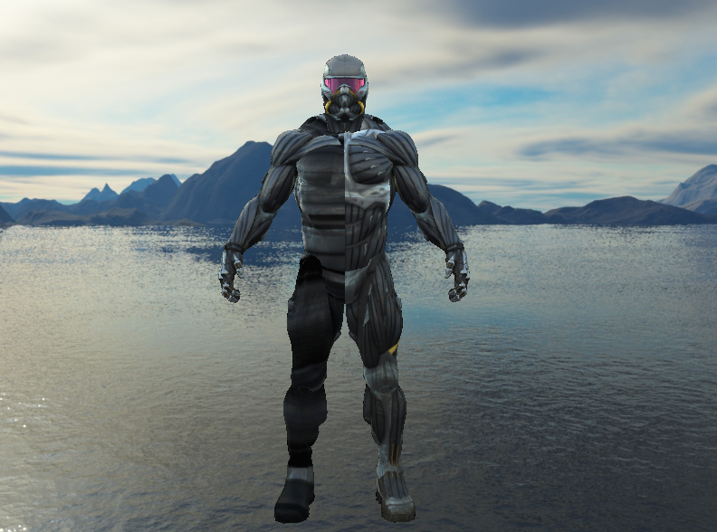
立方体贴图
顶点着色器
移除观察矩阵中的位移部分，移动不会影响天空盒的位置向量
天空盒的深度值为最大值1.0，只要它前面有一个物体，深度测试就会失败
深度函数，将它从默认的GL_LESS改为GL_LEQUAL
#version 420 core
layout (location = 0) in vec3 aPos;
out VS_OUT {
vec3 texCoord;
} vs_out;
uniform mat4 matView;
uniform mat4 matProjection;
void main()
{
vec4 pos = matProjection * matView * vec4(aPos, 1.0);
gl_Position = pos.xyww;
vs_out.texCoord = aPos;
}

Slide 8
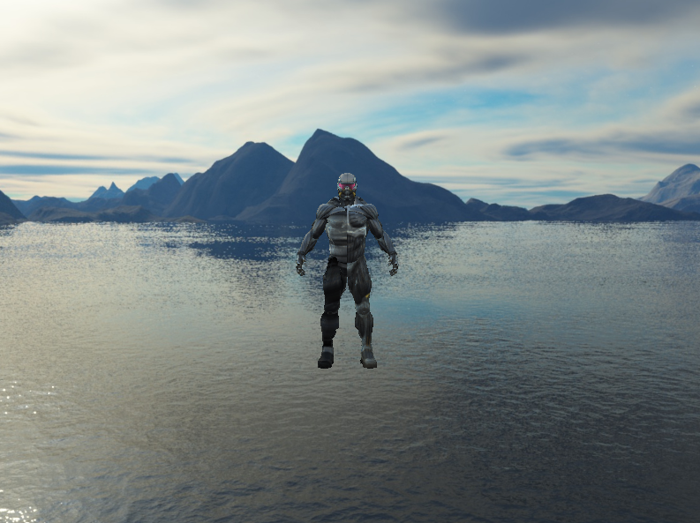
立方体贴图
片段着色器
移除观察矩阵中的位移部分，移动不会影响天空盒的位置向量
天空盒的深度值为最大值1.0，只要它前面有一个物体，深度测试就会失败
深度函数，将它从默认的GL_LESS改为GL_LEQUAL
#version 420 core
out vec4 FragColor;
in VS_OUT {
vec3 texCoord;
} fs_in;
uniform samplerCube texture_cube_map1;
void main()
{
FragColor = texture(texture_cube_map1, fs_in.texCoord);
}

Slide 9
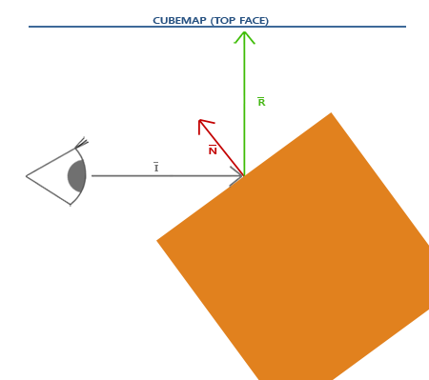
环境映射
反射表现为物体(或物体的一部分)反射周围环境，即根据观察者的视角，物体的颜色或多或少等于环境。
#version 420 core
out vec4 FragColor;
in VS_OUT {
vec3 FragPos;
vec3 Normal;
vec2 TexCoord;
} fs_in;
uniform samplerCube texture_cube_map1;
uniform vec3 viewPos;
void main()
{
vec3 norm = normalize(fs_in.Normal);
vec3 viewDir = normalize(viewPos - vec3(fs_in.FragPos));
//反射
vec3 R = reflect(-viewDir,norm);
vec3 reflection = vec3(texture(texture_cube_map1,R));
FragColor = vec4(reflection,1.0);
}

Slide 10
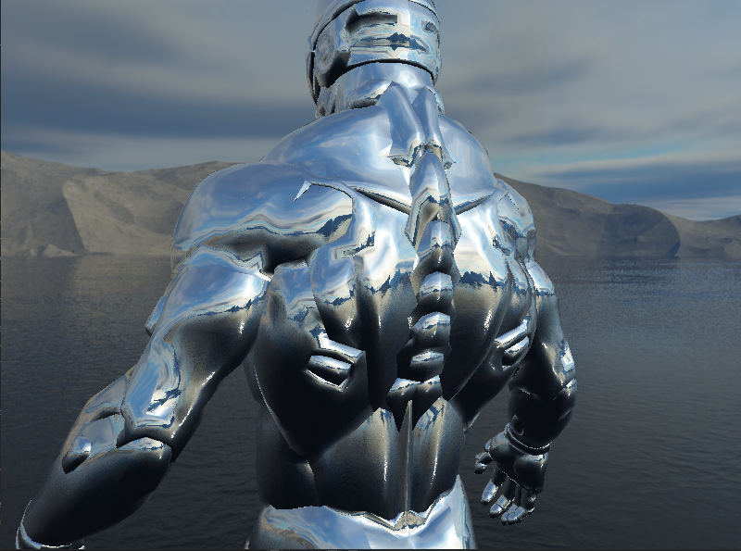
环境映射
反射表现为物体(或物体的一部分)反射周围环境，即根据观察者的视角，物体的颜色或多或少等于环境。
#version 420 core
out vec4 FragColor;
in VS_OUT {
vec3 FragPos;
vec3 Normal;
vec2 TexCoord;
} fs_in;
uniform samplerCube texture_cube_map1;
uniform vec3 viewPos;
void main()
{
vec3 norm = normalize(fs_in.Normal);
vec3 viewDir = normalize(viewPos - vec3(fs_in.FragPos));
//反射
vec3 R = reflect(-viewDir,norm);
vec3 reflection = vec3(texture(texture_cube_map1,R));
FragColor = vec4(reflection,1.0);
}

Slide 11
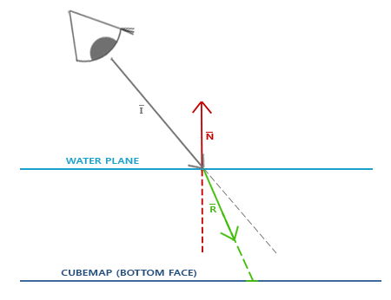
环境映射
环境映射的另一种形式是折射，和反射很相似。折射是光线由于传播介质的改变而产生的方向变化。
#version 420 core
out vec4 FragColor;
in VS_OUT {
vec3 FragPos;
vec3 Normal;
} fs_in;
uniform samplerCube texture_cube_map1;
uniform vec3 viewPos;
void main()
{
vec3 norm = normalize(fs_in.Normal);
vec3 viewDir = normalize(viewPos - vec3(fs_in.FragPos));
//折射
float ratio = 1.00 / 1.52;
vec3 R = refract(-viewDir, norm, ratio);
vec3 reflection = vec3(texture(texture_cube_map1,R));
FragColor = vec4(reflection,1.0);
}

Slide 12
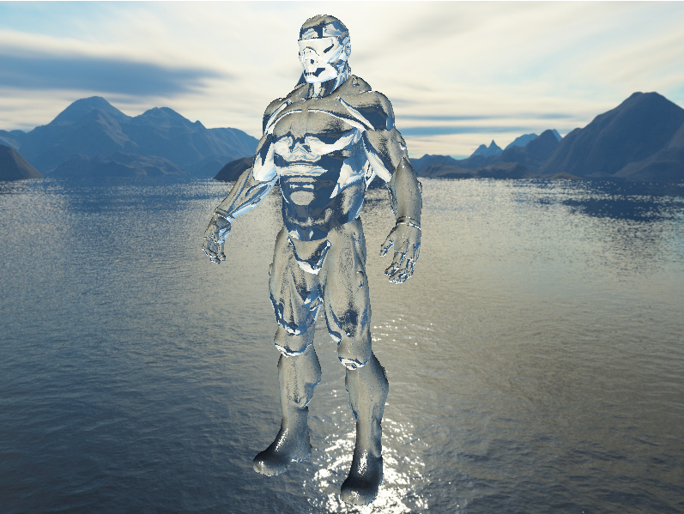
环境映射
环境映射的另一种形式是折射，和反射很相似。折射是光线由于传播介质的改变而产生的方向变化。
#version 420 core
out vec4 FragColor;
in VS_OUT {
vec3 FragPos;
vec3 Normal;
} fs_in;
uniform samplerCube texture_cube_map1;
uniform vec3 viewPos;
void main()
{
vec3 norm = normalize(fs_in.Normal);
vec3 viewDir = normalize(viewPos - vec3(fs_in.FragPos));
//折射
float ratio = 1.00 / 1.52;
vec3 R = refract(-viewDir, norm, ratio);
vec3 reflection = vec3(texture(texture_cube_map1,R));
FragColor = vec4(reflection,1.0);
}

Slide 13
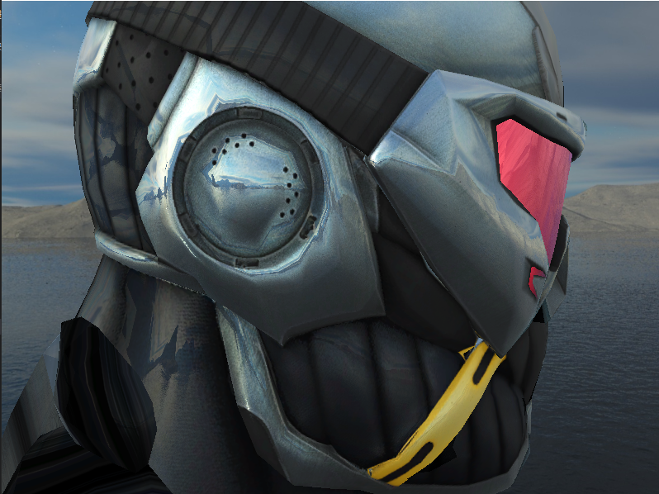
环境映射
引入反射贴图
#version 420 core
out vec4 FragColor;
in VS_OUT {
vec3 FragPos;
vec3 Normal;
vec2 TexCoord;
} fs_in;
uniform sampler2D texture_diffuse1;
uniform sampler2D texture_specular1;
uniform samplerCube texture_cube_map1;
uniform vec3 viewPos;
void main()
{
vec3 norm = normalize(fs_in.Normal);
vec3 viewDir = normalize(viewPos - vec3(fs_in.FragPos));
//反射
vec3 R = reflect(-viewDir,norm);
vec3 reflection = vec3(texture(texture_cube_map1,R));
vec3 specular = vec3(texture(texture_specular1,fs_in.TexCoord)) * reflection ;
float diff = max(normalize(dot(norm, viewDir)), 0.0f);
vec3 diffuse = diff * vec3(texture(texture_diffuse1,fs_in.TexCoord));
FragColor = vec4(specular + diffuse,1.0);
}

Slide 14
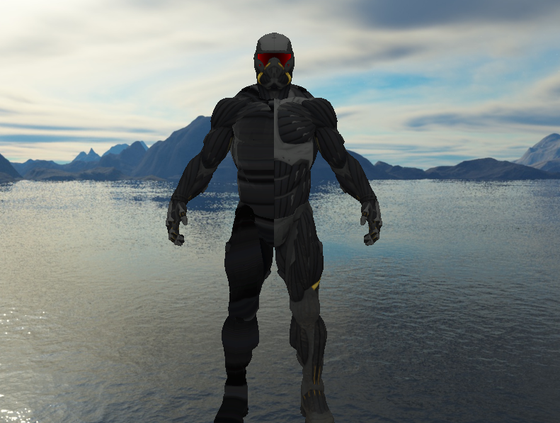
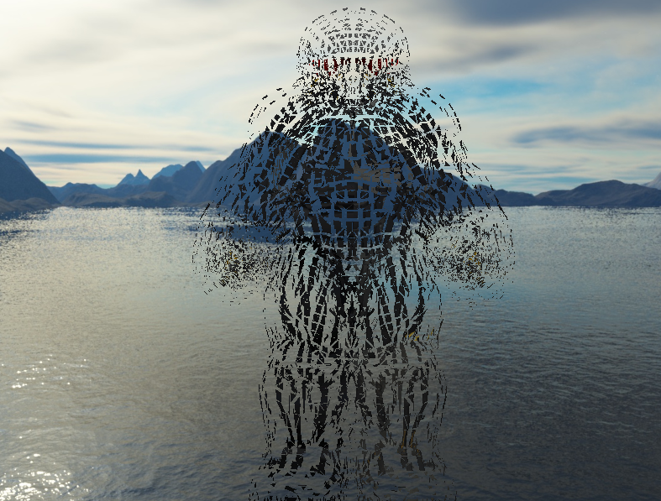
几何着色器
顶点移动爆炸
#version 330 core
layout (triangles) in;
layout (triangle_strip, max_vertices = 3) out;
in VS_OUT {
vec2 TexCoord;
} gs_in[];
uniform float time;
out vec2 TexCoords;
vec4 explode(vec4 position, vec3 normal)
{
float magnitude = 2.0;
vec3 direction = normal * ((time + 1.0) / 2.0) * magnitude;
return position + vec4(direction, 0.0);
}
vec3 GetNormal()
{
vec3 a = vec3(gl_in[0].gl_Position) - vec3(gl_in[1].gl_Position);
vec3 b = vec3(gl_in[2].gl_Position) - vec3(gl_in[1].gl_Position);
return normalize(cross(a, b));
}
void main() {
vec3 normal = GetNormal();
gl_Position = explode(gl_in[0].gl_Position, normal);
TexCoords = gs_in[0].TexCoord;
EmitVertex();
gl_Position = explode(gl_in[1].gl_Position, normal);
TexCoords = gs_in[1].TexCoord;
EmitVertex();
gl_Position = explode(gl_in[2].gl_Position, normal);
TexCoords = gs_in[2].TexCoord;
EmitVertex();
EndPrimitive();
}

Slide 15
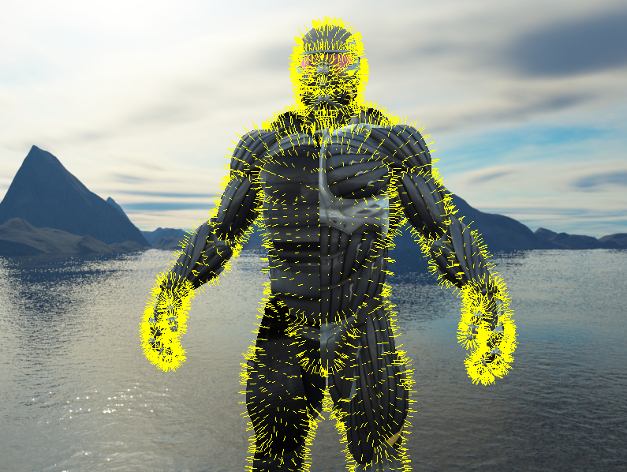
几何着色器
法向量显示
#version 420 core
layout (triangles) in;
layout (line_strip, max_vertices = 6) out;
in VS_OUT {
vec3 Normal;
} gs_in[];
const float MAGNITUDE = 0.2;
uniform mat4 matProjection;
void GenerateLine(int index)
{
gl_Position = matProjection * gl_in[index].gl_Position;
EmitVertex();
gl_Position = matProjection * (gl_in[index].gl_Position + vec4(gs_in[index].Normal, 0.0) * MAGNITUDE);
EmitVertex();
EndPrimitive();
}
void main()
{
GenerateLine(0); // first vertex normal
GenerateLine(1); // second vertex normal
GenerateLine(2); // third vertex normal
}

Slide 16
2
实例化

Slide 17
实例化
OpenGL在绘制顶点数据前会做很多准备工作(比如告诉GPU该从哪个缓冲读取数据，从哪寻找顶点属性，而且这些都是在相对缓慢的CPU到GPU总线(CPU to GPU Bus)上进行的)，所以绘制大量模型实例(Instance)时，会因为绘制调用过多而达到性能瓶颈。
实例化(Instancing)能够将数据一次性发送给GPU，然后使用一个绘制函数让OpenGL利用这些数据绘制多个物体。
for(unsigned int i = 0; i < amount_of_models_to_draw; i++)
{
DoSomePreparations(); // 绑定VAO，绑定纹理，设置uniform等
glDrawArrays(GL_TRIANGLES, 0, amount_of_vertices);
}

Slide 18
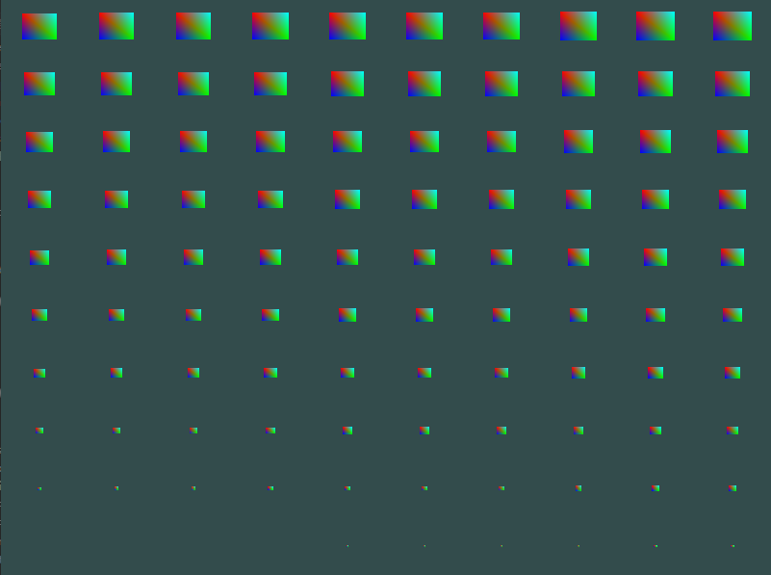
实例化
配置实例化数组顶点属性
glBindVertexArray(m_uiVAO);
GLuint uiInstanceVBO;
glGenBuffers(1, &uiInstanceVBO);
glBindBuffer(GL_ARRAY_BUFFER, uiInstanceVBO);
glBufferData(GL_ARRAY_BUFFER, vecOffset.size() * sizeof(glm::vec2), &vecOffset[0], GL_STATIC_DRAW);
glEnableVertexAttribArray(5);
glVertexAttribPointer(5, 2, GL_FLOAT, GL_FALSE, sizeof(glm::vec2), (void*)0);
glVertexAttribDivisor(5, 1);
glBindVertexArray(0);
glBindBuffer(GL_ARRAY_BUFFER, 0);
if (m_spRenderState->GetDrawMode() == DRAW_MODE::ELEMENT_INSTANCE_MODE)
{
m_uiInstance = vecOffset.size();
}
对象渲染
glDrawElementsInstanced(GL_TRIANGLES, static_cast<unsigned int>(m_vecIndexs.size()), GL_UNSIGNED_INT, 0, m_uiInstance);

Slide 19
实例化
顶点着色器
#version 420 core
layout (location = 0) in vec3 aPos;
layout (location = 2) in vec3 aColor;
layout (location = 5) in vec2 offset;
out vec3 Color;
void main()
{
vec2 pos = vec2(aPos) * (gl_InstanceID / 100.0);
gl_Position = vec4(pos+offset,0.0,1.0);
Color = aColor;
}

Slide 20
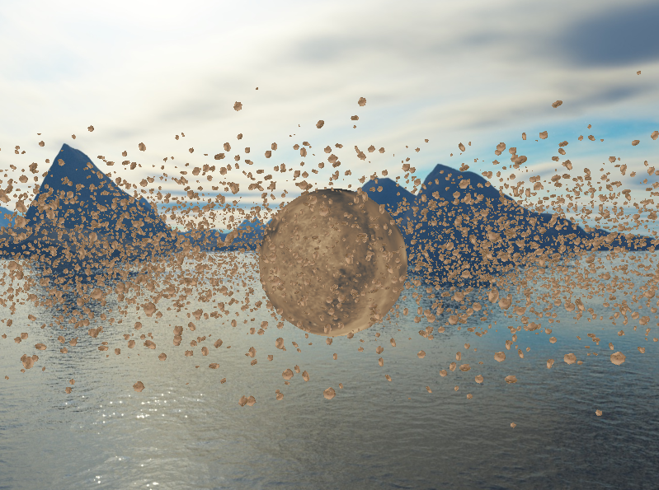
实例化
配置实例化数组顶点属性
glBindVertexArray(m_uiVAO);
GLuint uiInstanceVBO;
glGenBuffers(1, &uiInstanceVBO);
glBindBuffer(GL_ARRAY_BUFFER, uiInstanceVBO);
glBufferData(GL_ARRAY_BUFFER, vecOffset.size() * sizeof(glm::mat4), &vecOffset[0], GL_STATIC_DRAW);
glEnableVertexAttribArray(5);
glVertexAttribPointer(5, 4, GL_FLOAT, GL_FALSE, sizeof(glm::mat4), (void*)0);
glEnableVertexAttribArray(6);
glVertexAttribPointer(6, 4, GL_FLOAT, GL_FALSE, sizeof(glm::mat4), (void*)(sizeof(glm::vec4)));
glEnableVertexAttribArray(7);
glVertexAttribPointer(7, 4, GL_FLOAT, GL_FALSE, sizeof(glm::mat4), (void*)(2 * sizeof(glm::vec4)));
glEnableVertexAttribArray(8);
glVertexAttribPointer(8, 4, GL_FLOAT, GL_FALSE, sizeof(glm::mat4), (void*)(3 * sizeof(glm::vec4)));
glVertexAttribDivisor(5, 1);
glVertexAttribDivisor(6, 1);
glVertexAttribDivisor(7, 1);
glVertexAttribDivisor(8, 1);
glBindVertexArray(0);
glBindBuffer(GL_ARRAY_BUFFER, 0);
if (m_spRenderState->GetDrawMode() == DRAW_MODE::ELEMENT_INSTANCE_MODE)
{
m_uiInstance = vecOffset.size();
}

Slide 21
实例化
配置实例化数组顶点属性
#version 420 core
layout (location = 0) in vec3 aPos;
layout (location = 1) in vec2 aTexCoord;
layout (location = 5) in mat4 aModel;
out VS_OUT {
vec2 texCoord;
} vs_out;
uniform mat4 matView;
uniform mat4 matProjection;
void main()
{
gl_Position = matProjection * matView * aModel * vec4(aPos, 1.0);
vs_out.texCoord = aTexCoord;
}

Slide 22
谢谢大家
THANK YOU FOR WATCHING

